Slide 1
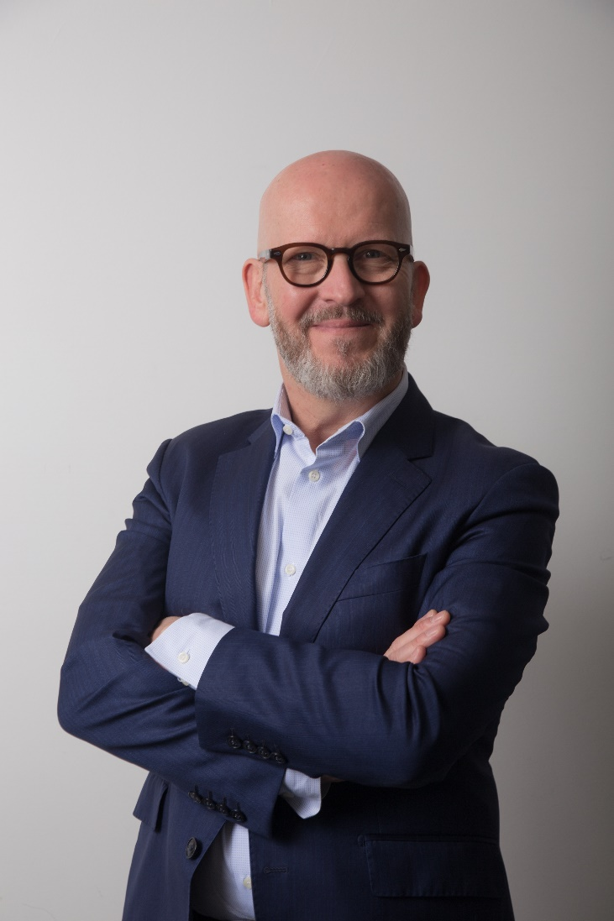
Christophe BAUJAULT
ECE Director

Slide 2
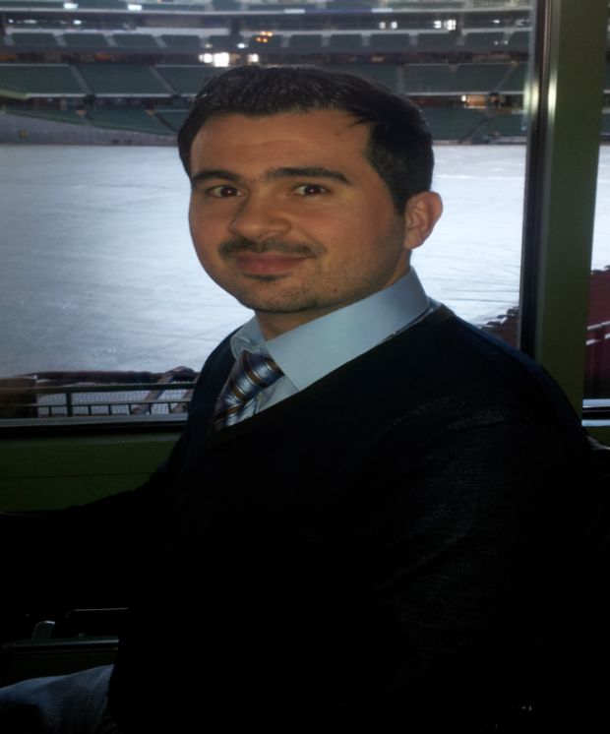
Salim NAHLE
Head of Information Systems, Cybersecurity and Big Data Department

Slide 3

One Year Ago
Notes:
In the recent white papers on the defense and national security, a huge focus is now given to cybersecurity, where a huge cyberattack on strateginc IS is highly considered and constitute a huge challenge for France and Europe. The cyberspace is now considered the 5th space of war after Ground, Air, marine and extraspace. The conclusion is simple, the country shall develop its defensive cybersecurity but also it offensive means.
Shortage in security skills.
Project start in January
Objectives: creating an outstanding environment for developing skills
Finding skills to train our students in Microsoft security constitutes a real challenge it self. Historically in France security is taught on othe OS.
The specialization is now opened. First group to have their diploma in 2019
Nothing could be achieved without the huge contribution of our partners especially Microsoft team lead by Arnaud Jumelet who was a huge asset

Slide 4

One Year AGO
Notes:
French National Cybersecurity Agency
Certifeies that what we propose responds the requirements in

Slide 5




Program
Identity and Access Management in Microsoft Environment
Windows Security
Cybersecurity policies, standards and methodologies
Penetration Testing
Students Final Year Projects
Internships / conferences
Risk Analysis
Network Security
Incident Response, Forensics and Reverse Engineering
Cryptography
Identity and Access Management
Information Systems Security
Notes:
3 objectives:
label: multidisciplinary program, in which we cover all the themes required by the ANSSI
Innovative teaching methods:
Expertise transfer

Slide 6
Internships
Forensic Analysis on Azure
IAM Production Engineer
Risk analysis
Security Support Engineer
Cybersecurity Consultant
Azure AD
Azure ATP
Big Data and Cybersecurity
Digital Trust
Governance, Risk and Consulting
Evaluation of reference SIEMs
Implementation of security controls in DevOps
Orange Cyberdefense
Bouygues Telecom
Wavestone
Capgemini
IBM FRANCE
SourceWell Global Inc.
AIR FRANCE
THALES SIX GTS FRANCE SAS
VISEO TECHNOLOGIES
ATOS WORLDLINE
Accenture
Thales Communications & Security
AIRBUS DEFENCE AND SPACE
NATIXIS
@

Slide 7
Final Year Projects
Visualization of WINDOWS EVENT LOGS
RBAC delegation model in Active Directory
Automation of Vulnerabilities auditing on Active Directory
Notes:
STUDY OF WINDOWS EVENT LOGS: CREATION OF A GRAPHICAL VISUALIZATION TOOL
Development a tool able to create a RBAC delegation model in Active Directory.. To face a strong turnover and create an infrastructure more secure to changes • Offer more flexibility in system administration and identity management as the business organization changes • Limit everyone's privileges to the bare needs
Creation a tool that automates auditing Vulnerabilities on Active Directory "

Slide 8
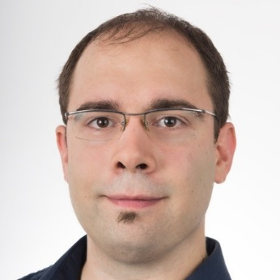
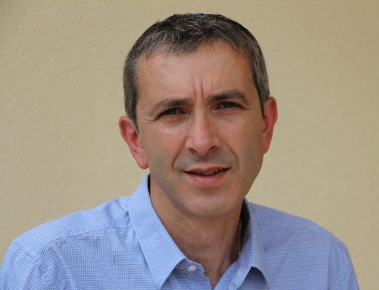
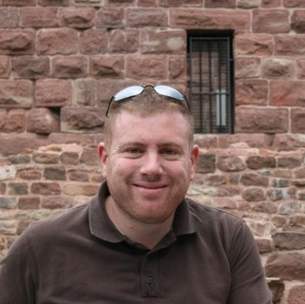
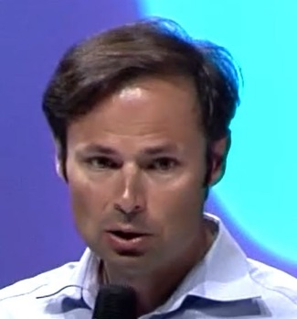
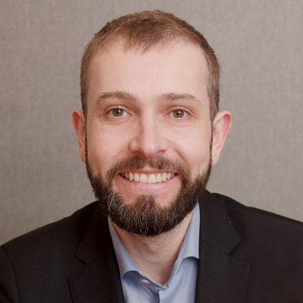
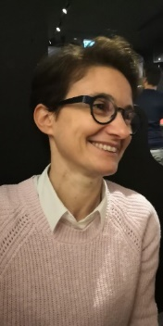

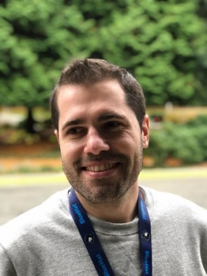
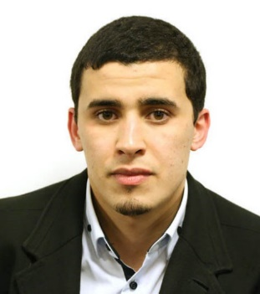
Dream Team
Alexandre LAFARGUE
Albertino MATIAS
Benjamin BOUCKENOOGHE
Daniel PASQUIER
Arnaud
JUMELET
Karine SANGUINET
François TACHOIRES
Pierre AUDONNET
Mohamed ANTRI
Notes:
This great team of Microsoft lead by Arnaud, has been showing up a lot, commitment, availability, motivation and also LOVE, love to share and educate

Slide 9

Rob Lefferts
Corporate Vice President, Program Management, Microsoft 365 Security and Compliance
Notes:
En tant que Corporate Vice-Président chez Microsoft 365 Security, Rob Lefferts est responsable de l'expérience sécurité utilisateur la plus complètede Microsoft 365.

